Slide 1

Masonhill Crematorium Memorials
Created by Megan Ferguson

Slide 2
Overview
Choice of memorials within the grounds of Masonhill Crematorium, all memorials are on a lease of either 10 or 20 years.
There are several options for the interment of ashes both under and above ground for the duration of the lease.
Memorial appointments can be made by calling 01292 266051. A member of staff can walk round the grounds and discuss the memorial options available to you.
No unauthorised memorials are permitted within the grounds of Masonhill Crematorium.

Slide 3
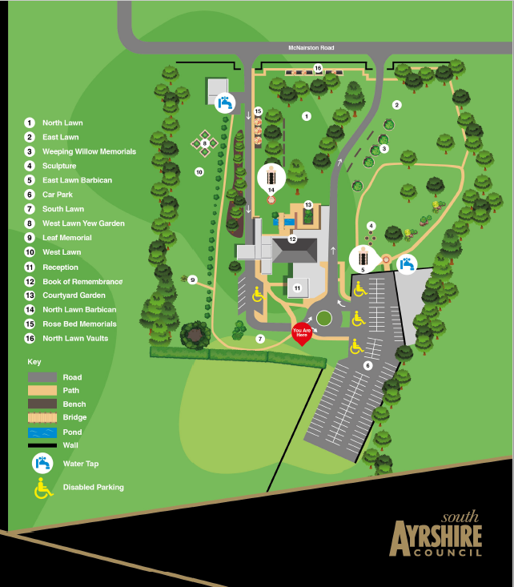
Map of Grounds

Slide 4
Styles of Memorials
Boulder A
Boulder A1
Boulder B
Boulder C

Slide 5
Styles of Memorials Cont’d
Book of memories
Mini Headstone
Plaque F - Shrub & Plaque

Slide 6
Styles of Memorials Cont’d
Bench Plaque
Memorial Leaf

Slide 7
Memorial Garden Seats
Teak Garden Seats with cast bronze plaques can be placed at an agreed location within the grounds of the crematorium.
Prices start from £1506.00

Slide 8
Courtyard Niche Wall
Above ground placement of cremated remains set in this Italianate black granite wall. Cremated remains would be placed inside a special casket. The plaque holds 2 inscriptions of four lines in Roman style text.
Prices start from £499.00

Slide 9
The Courtyard Garden
The focal point of the Courtyard area is the raised garden, which has plaques surrounding the sides. The Plaque holds 2 inscriptions four lines of Roman style text. Between the flowerbed and the plaques there is a channel designed to hold pot plants. The garden planting is seasonally changed.
Prices start at £992.00

Slide 10
South Path
Centrally placed and easily located on route to the chapel, a boulder can be situated next to a dwarf conifer, already planted, to either side of a red brick pathway.
Available on the South Path.
Prices start from £746.00

Slide 11
Rose bed Memorial
Choice of two styles of bolder which sits surrounding rose bed. Plaque available in landscape or portrait setting within the boulder.
Available on the North Lawn.
Prices start from £746.00

Slide 12
Border Memorial
Single or double boulder with or without a vase which is set on stones along the wall and fence line.
Available on the North Lawn and East Lawn.
Prices start from £746.00

Slide 13
North Lawn Vaults
Below ground placement of up to two sets of cremated remains. The plaque holds 2 inscriptions of four lines of Roman style text. A flower holder is included for cut flowers only.
Available on the North Lawn.
Prices start from £1326.00

Slide 14
Barbican Plaques
Black granite plaque with coloured sand blasted motif secured to a buff coloured granite tower.
These are available on both the North & East Lawn.
Prices start from £392.00

Slide 15
Private Garden
Individual memorial within a cluster of four circles, holding a suitable shrub and a memorial of your choice.
Available on the East Lawn.
Prices start from £2154.00

Slide 16
Weeping Tree Memorial
A book of memories on segmented granite sets are placed on quartz chips surrounding the weeping tree.
Available on the East Lawn.
Prices start from £1120.00

Slide 17
Individual Family Garden
Limited availability for these individually designed gardens, which can accommodate up to three memorials and a selection of plants.
Available on the East Lawn.
Prices start from £4400.00

Slide 18
Memorial Leaf
This is an ‘evergreen’ shrub sculpted from steel. Brass coloured, weatherproof name plates are attached to the leaf shapes.
Available on the West Lawn.
Prices start from £160.00

Slide 19
Shrub & Plaque
6” x 4” granite or cast bronze plaque with stake placed within the kidney shaped heather bed.
Available on the West Lawn.
Prices start from £677.00

Slide 20
Wall Plaques
Granite or cast bronze wall plaques of varying sizes.
North Lawn starts from £246.00
East Lawn starts from £424.00

Slide 21
Yew Garden
Segmented granite sets in a diamond design, covered with quartz chipping surrounding a themed planting. The memorial is a mini black granite headstone with a base and vase.
Available on the West Lawn.
Prices start from £1120.00

Slide 22
Price List
MEMORIAL PRICES |  | 10 Year Lease | 20 Year Lease
Memorial Leaf |  | £160 | £195
N Lawn granite Wall Plaques | 12x6 | £246 | £291
N Lawn granite Wall Plaques | 12x10 | £282 | £334
Barbican plaque * (including coloured motif) |  | £392 | N/A
E Lawn bronze Wall Plaques | 12x6 | £424 | £457
E Lawn granite Wall Plaques | 7x7 | £583 | £632
Dedicated Shrub & Plaque (6x4) |  | £677 | £853
E Lawn granite Wall Plaques | 14x7 | £697 | £767
The Courtyard Niche Wall (top 4 rows) * |  | £499 | £711
E Lawn bronze Wall Plaques | 12x12 | £684 | £797
The Courtyard Niche Wall (bottom 3 rows) * |  | £644 | £895
The Courtyard Niche Wall (middle 6 rows) * |  | £746 | £1041
Border Memorial |  | £746 | £1041
Rosebed Memorial |  | £746 | £1041
The Courtyard Garden* |  | £992 | £1148
Weeping Tree Memorial |  | £1120 | £1345
Fir Tree Memorial |  | £1120 | £1345
East Lawn Memorial Boulder and vase |  | £1120 | £1345
Yew Gardens |  | £1120 | £1345
North Lawn Vaults * |  | £1326 | £1626
Garden Seat incl. Plaque |  | £1506 | £1954
Private Garden/Tree |  | £2154 | £2638
Individual Family Garden by appointment |  | £4400 | £5722
* A motif is included in the fee for these memorials but a photo plaque is extra
(4 x 6 cm) Black and white £116.00
(4 x 6 cm) Colour £160.00

