Slide 1

South Ayrshire Council
Information and Advice Hub
Webinar 2022

Slide 2

Information and Advice Hub Webinar 2022
South Ayrshire Council commitment to closing the gap and reducing poverty and disadvantage by providing a full circle approach to advice and information.
Maximising income through Welfare Benefits
Managing outgoings through effective Budget Planning
Addressing Fuel Poverty

Slide 3
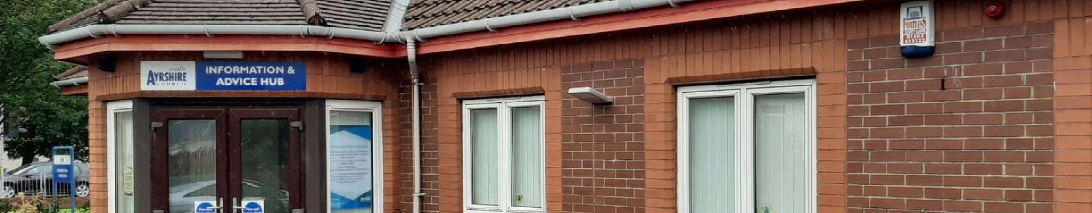
Who are we?
A free, confidential, and impartial, information and advice service to people living in South Ayrshire.
Our advisors are fully trained to deal with welfare rights and issues relating to money and debt advice. We can also refer to a number of partner agencies to ensure residents of South Ayrshire receive all of the support they need tailored to their individual circumstances.

Slide 4

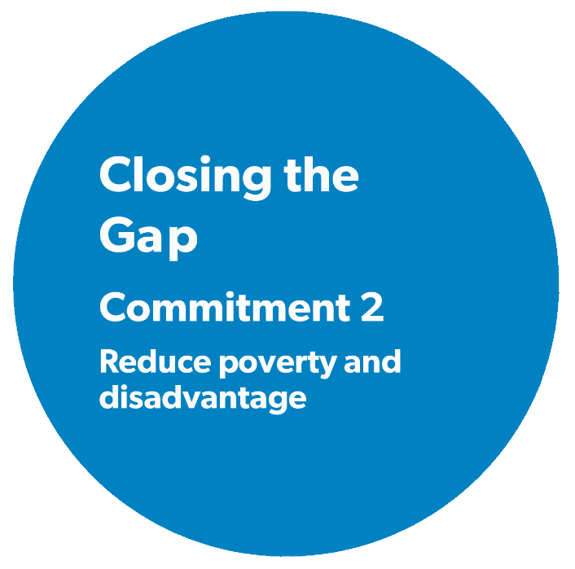


Information and Advice Hub Services
General Advice and Information on all Benefits
Personal
Budgeting
Support
Better
Off
Calculations
Income
Maximisation
Form Filling
(CDP, ADP, PIP)
Appeals;
Written Representation
Struggling to make Credit Card or
Loan Repayments
Negotiate with Creditors on Clients Behalf
Threat
Of
Eviction
Partnership
Working
Info and Advice Hub
Community Team
Cost of Living/Fuel
Poverty

Slide 5

Tackling Poverty and Disadvantage
Welfare Rights Training and Spot the Signs of Debt – Health and Social Care Partnership
Raising Awareness of Services we offer to all our colleagues within SAC
Social Media – Information and Advice Hub page on Facebook
Training provided to newly qualified GPs
Guardian Surgical – Redundancies
Foodbanks – Food Pantries
Education
Drop ins at Local Groups and Organisations
Ukraine Support Team
Homeless – Supported Accommodation
NHS – various services
Libraries
Home visits for our most vulnerable residents in South Ayrshire

Slide 6


Community Team Locations… and Growing!
Troon Old Parish Church
Dundonald Foodbank
Prestwick Library
Troon Library
Secession House
Annbank Parish Church
Girvan Foodbank
Girvan Food Pantry
Glendoune Centre
Maybole Foodbank
Southside Church Foodbank
Lochside Church Foodbank
Castlehill Church
Care and Share
Ayr Food Pantry
Newton Primary
Prestwick Food Bank

Slide 7

How to contact us?
Online Referrals
You can now make a referral for yourself or on behalf of someone else by completing our online referral form
Telephone
Call us on 0300 123 0900. We are open Monday - Thursday 9am - 4.45pm and Friday 9am - 4pm.
Email
informationandadvicehub@south-ayrshire.gov.uk
Text
Text us on 07491163382, please include your name, a brief description of your enquiry.

Slide 8
South Ayrshire Council
Information and Advice Hub
Maximising Income through Welfare Benefits

Slide 9



Maximising Income through Welfare Benefits
What Benefits are available?
Benefit Check
Better Off Calculations
Income Maximisation

Slide 10

Universal Credit
Universal Credit is a means-tested benefit for people of working age.
It replaces six means-tested benefits:
Income Support
Income-based Jobseeker’s Allowance (JSA)
Income-related Employment and Support Allowance (ESA)
Housing Benefit
Child Tax Credit
Working Tax Credit.
The above six benefits are also known as legacy benefits.

Slide 11


Legacy Benefits
Contribution based Employment And Support Allowance
Must have paid enough national insurance contributions
Must have a “limited capability for work or work related activity”
Depending on severity of illness/disability some claims limited to 365 days
Contribution based Job Seekers Allowance
Must have paid enough national insurance contributions
* May also have to claim Universal Credit for housing costs.
Housing Benefit
Supported/Sheltered Accommodation
Temporary Accommodation
State Pension Age

Slide 12

Carers Allowance
Eligibility;
If you care for someone at least 35 hours a week and they get certain benefits.
You do not have to be related to, or live with, the person you care for.
You do not get paid extra if you care for more than one person.
If someone else also cares for the same person as you, only one of you can claim Carer’s Allowance.
The person you care for must already get one of these benefits:
Personal Independence Payment - daily living component
Disability Living Allowance - the middle or highest care rate
Adult Disability Payment – daily living component
Attendance Allowance – any rate
Constant Attendance Allowance at or above the normal maximum rate with an Industrial Injuries Disablement Benefit
Constant Attendance Allowance at the basic (full day) rate with a War Disablement Pension
Armed Forces Independence Payment
Child Disability Payment - the middle or highest care rate

Slide 13


Social Security Scotland
Social Security Scotland is an Executive Agency of the Scottish Government. In Scotland we have a number of devolved benefits;
Child Disability Payment
Young Carer Grant
Carer's Allowance Supplement
Cold Weather Payments and Winter Fuel Payments
Scottish Child Payment
Adult Disability Payment

Slide 14

Child Disability Payment
Child Disability Payment is a benefit for disabled children and young people who live in Scotland. It is a payment to help with the extra care and mobility costs of having a child who has a disability or health condition.
It is replacing the Department for Work and Pensions benefit called Disability Living Allowance (DLA) for children and young people.
52,000 children and young people in Scotland are in receipt of DLA and some claimants have already migrated onto Child Disability Payment.
You cant get the Child Disability Payment if you are already in receipt of Child (DLA).
The rates for both benefits are the same.

Slide 15
Child Disability Payments
Components
Care
The child has care needs if they need help with ‘bodily functions’, for example, eating, washing, getting dressed and going to the toilet. These care needs can also include help which allows the child to take part in social activities.
Mobility
The child has mobility needs if they cannot walk outdoors or go on an unfamiliar route without guidance or supervision from someone else. For example, this might apply if the child is blind, is unable to walk or has a lot of difficulty walking. The child may also be treated as having mobility needs if they have severe learning difficulties or severe behavioural problems.
Notes:
Please note that Child DLA has been replaced by Child Payment for many claimants

Slide 16

Young Carer Grant
The Young Carer Grant is a payment of £326.65 from Social Security Scotland.
It’s paid once a year to carers aged 16-18 years, who do at least 16 hours of caring a week on average, but don’t receive Carer’s Allowance.
You don’t need to have worked or paid National Insurance to get the grant, and it doesn’t matter what your income is or if you have any savings.
You can be at school, in further education like at college, in work or unemployed.

Slide 17
Carers Allowance Supplement
The Carer's Allowance Supplement is a twice-yearly payment made by Social Security Scotland.
It is a temporary payment, until Carer's Allowance is replaced by a new Scottish benefit. It has been introduced to quickly increase the amount of Carer's Allowance paid to carers in Scotland.
The Carer's Allowance Supplement for 2022 is £245.70.
The payment is a lump sum which covers a six month period, either April to September or October to March.

Slide 18

Scottish Child Payment
Scottish Child Payment helps towards the costs of supporting your family. It's a weekly payment of £25 that you can get for every child you look after who's under 16 years of age. You'll get the payment every 4 weeks if your application is successful.
It's up to you what you choose to spend the money on. You could use Scottish Child Payment for things like:
travel costs
nappies and other essentials
childcare
family days out

Slide 19

Adult Disability Payment
This new payment, to be administered by Social Security Scotland, will replace Personal Independence Payment (PIP), which is currently delivered by the UK Government’s Department for Work and Pensions (DWP).
People who currently get disability benefits from Department for Work and Pensions will have their awards transferred to the new Scottish system in stages after the new benefits are introduced from summer 2022.
A new definition of terminal illness has been introduced, removing the time requirement that a person must reasonably be expected to die within six months and instead using the clinical judgement of doctors and registered nurses involved in the individual’s care.

Slide 20



Adult Disability Payment
Adult Disability Payment is extra money to help you if you have a disability or long-term health condition that affects your everyday life.
Adult Disability Payment is made up of 2 parts:
Daily Living
Mobility
You may qualify for one or both parts

Slide 21
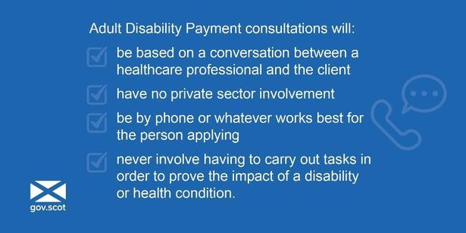
Adult Disability Payment cont.

Slide 22
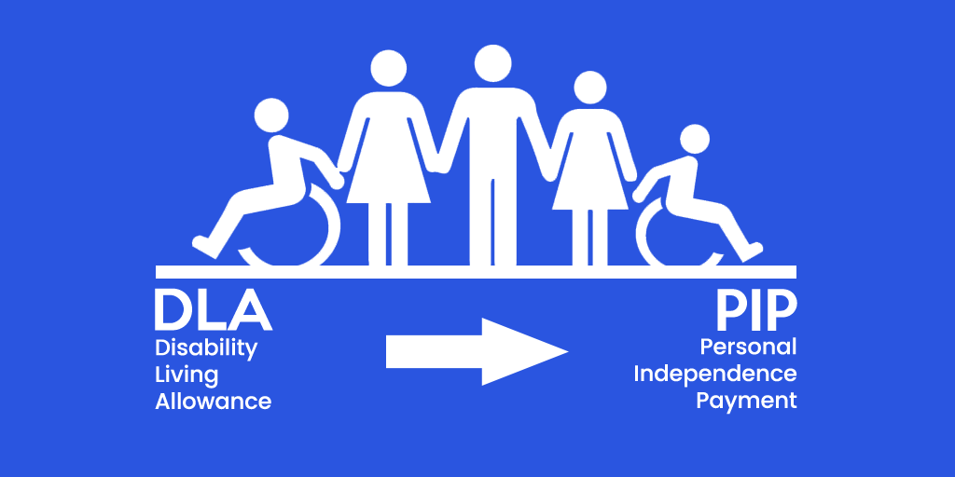
Disability Living Allowance
DLA is a disability benefit for children who have extra care or mobility needs.
Children can have any type of illness or disability, as long as it can be shown;
They need more care, attention or supervision than a child of similar age who is not disabled.
They have difficulty walking, or getting around outdoors, or mobilising in an unfamiliar place. Again the child’ s mobility will be assessed based on that of a child of similar age.
*DLA will migrate onto Child Disability Payment

Slide 23
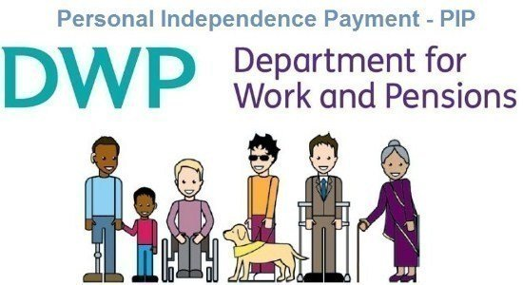
Personal Independence Payment
Personal Independence Payment (PIP) is money for people who have extra care needs or mobility needs (difficulty getting around) as a result of a disability.
* PIP claimants will migrate onto Adult Disability Payment
There are two parts called components:
The daily living component.
The mobility component.
Claimants may qualify for one or both of them.

Slide 24
Attendance Allowance
Attendance Allowance is non means tested benefit for people who have reached retirement age and have care needs. They may have care needs if they need help with;
Activities of daily living, such as getting dressed, going to the toilet or having someone to supervise them so they do not hurt themselves.
They can have any type of disability or illness, including sight or hearing impairments, or mental health issues such as dementia or depression.
** Attendance Allowance does not cover mobility needs

Slide 25
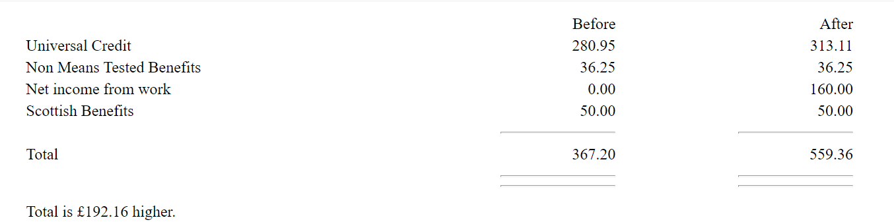
Case Study 1
Single parent Kim has 2 children aged 4 and 12 years old. Kim met with an advisor at her local Foodbank having recently been offered a job at 16 hours per week for £10 per hour. Kim was concerned about how this change would impact her household income
Benefit Check
At present Kim is in receipt of Universal Credit Standard Allowance, Child Element x2, Housing Costs along with Child Benefit and Scottish Child Payment (eligibility changed 14.11.22)
Following a benefit calculation our advisor was able to provide Kim with entitlement should she decided to take the job.
Better off calculation -

Slide 26
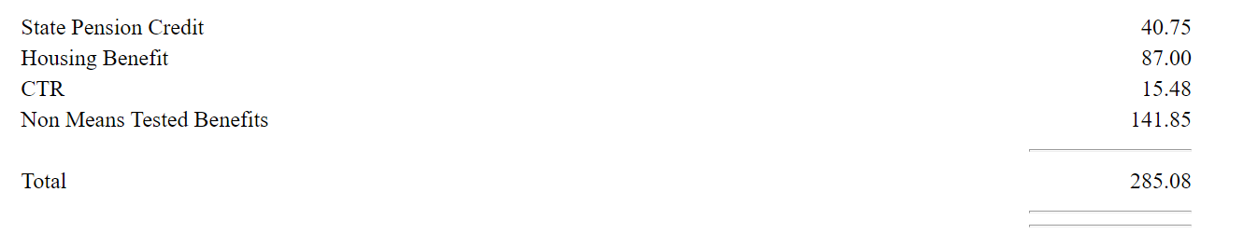
Case Study 2
Jim (77) telephoned seeking advice on any financial assistance he may be entitled to due to a recent change of circumstances. Jim advised that his wife has been placed permanently into a residential nursing home as she has dementia and it was no longer safe for her to live independently at home.
Jim is concerned about the reduction in his income as his wife’s State Retirement Pension is paid directly to the Nursing Home and he is finding it difficult to manage. Jim also confirmed that there are no joint savings or capital.
Our advisor completed a benefit check for Jim and advised him that for benefit purposes he is now treated as a single claimant.
Jim's only income at present was State Retirement Pension of £141.85 per week and was struggling to cover rent and council tax.
Income Maximised –
£143.23 better off

Slide 27
South Ayrshire Council
Information and Advice Hub
Managing Outgoings Through Effective Budget Planning

Slide 28

Effective Budget Planning
Creating a budget is the first step towards taking control of your finances and getting your situation back on track. Budgeting helps you to see where your money is going, so it’s easier to make sure that you’ve covered all of your priority bills.
Budgeting is the best way to see where savings can be made. As most household bills and debt payments are made monthly we suggest that people change all the figures in their budget to monthly amounts to make it easier to see the outcome.
Setting up a budget means you are:
less likely to end up in debt
less likely to get caught out by unexpected costs
more likely to be able to maintain a good credit rating
more likely to be accepted for a mortgage or loan
able to spot areas where you can make savings

Slide 29


Creating a Budget
Work out your total income
Add together all the income you get each month. Make sure you include everything, whether its wages, benefits or pensions. If some of your income is paid weekly or 4 weekly, you’ll need to turn these figures into calendar monthly ones.
To do this you need to multiply the weekly figure by 52 and then divide this by 12. This will then give you a calendar monthly figure to include in your budget.

Slide 30


Creating a Budget
Make a list of everything you spend each month
Start with your priority bills, such as your mortgage, rent, council tax and utilities like gas and electricity. These are classed as priorities, because they have the most severe consequences if your payment is late or if you miss a payment.
Next, write down what you usually spend on living costs such as food, clothing and toiletries. Shopping receipts can help you work out what you typically spend on these items each month.
You need to include amounts for things that you only pay for once a year or less often, such as Christmas, car repairs or vets bills. To do this you need to divide the yearly cost by 12 to give you a monthly figure which you can include in your budget. You can then set this money aside until the bill is due.

Slide 31


Creating a Budget cont.
Once you have worked out income and expenditure – surplus or deficit?
If you’ve got any money left over after you’ve paid for everything you have a ‘budget surplus’. If you’re spending more money than you’ve got coming in you have a ‘budget deficit’.

Slide 32

Budgeting Case Study
A recent enquiry we received was from a client who was very upset and struggling to meet his everyday costs, we sent out a blank budget planner which he then completed and returned with one full month’s bank statement.
The advisor reviewed his budget planner against his bank statement. The planner had showed him being able to meet his everyday costs with a surplus remaining.
On reviewing his bank statement it was picked up that he was spending a lot of money on takeaways and online gaming that he had not included in his budget. When the advisor brought this to his attention he did not realise that he was spending so much. Through further discussion with the advisor he made the informed choice to cut down on his spending in these areas. A new budget was completed which resulted in surplus income.
Customer stated he felt a sense of relief having taken control of his finances.

Slide 33




Money Advice
If you are struggling to manage re-payments or have fallen into arrears we are here to help.
This includes, but not limited to:
Loans
Credit Cards
Mortgage
Car Finance
Council Tax
Gas and Electricity
Catalogue Accounts

Slide 34
South Ayrshire Council
Information and Advice Hub
Addressing Fuel Poverty

Slide 35
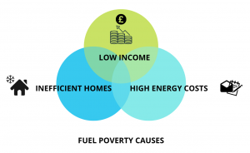
Addressing Fuel Poverty
What is Fuel Poverty?
A household is in fuel poverty if the fuel costs necessary for the home in which members of the household live are more than 10% of the household’s income.

Slide 36



Addressing Fuel Poverty cont
Winter Fuel Payment
Cold Weather Payment
Warm Home Discount
South Ayrshire Council – Household Boost Fund
Scottish Welfare Fund
Energy Bill Support Scheme
Cost of Living Payments
Home Energy Scotland
British Gas Energy Trust
Energy Agency

Slide 37
SAC Household Boost Fund
The purpose of the Household boost fund is to support residents of South Ayrshire in the most need with food, energy, and other essential items during the cost-of-living crisis. Applications are limited to one per household.
Eligibility
Resident of South Ayrshire
In financial hardship
Loss or reduction in hours/wage
Benefit dispute – sanction, delay in processing application or refusal of benefit
Relationship breakdown
Bereavement
Energy arrears/unable to afford monthly cost
Unable to properly feed themselves and family
Reports replying on credit to afford essentials such as food, gas and electric

Slide 38

SAC Household Boost Fund cont
Evidence Required
Completion of a benefit check and budgeting assessment by IAAH that demonstrates financial hardship
Savings of less than £1000 per household
A full bank statement dated within the last 3 months, for audit purposes the bank statement must show clients name, address, sort code and account number
Household Boost Fund Payments
£200 single
£350 couple or multiple household
£50 for each addition child in receipt of child benefit up to a maximum of 3 children

Slide 39
Summary and Questions
Our council commitment to closing the gap and reducing poverty and disadvantage by providing a full circle approach to advice and information
Maximising Income through Welfare Benefits
Managing outgoings through effective Budget Planning
Addressing Fuel Poverty

